Slide 1




5G+AI网络应用专题赛
ITU-ML5G-PS-005
Network anomaly detection based on logs
Chin：Qin YuKun，Song Yong，Xie Yuchen，Wei QiangShen

Slide 2
Background-Logs are valuable for network maintenance with existing challenges
Huge chunks of data was generated by Network Equipment and these information can be used to detect existing faults to improve the network maintenance.
Log Application
Plenty of data（1GB/H+）
Highly increasing
Various logs（Exchanger、Server、Router, etc.）
Unstructured data
Low-interpretable
Imbalanced
Abnormal Detection
Event Alarm Convergence
Alarm Root Analysis
Fault Locating on Resource Chain
System Evaluation
Fault Warning
……

Slide 3
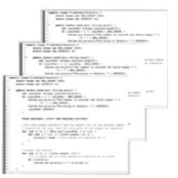
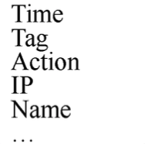
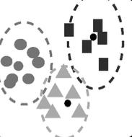
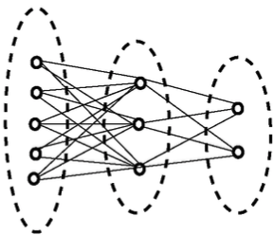
Background——NLP & Abnormal Detection
Network Abnormal Detection based on Logs was composed by NLP and typical abnormal detection.
Log Collection
Log Parsing
Feature Extraction
Abnormal Detection
Batch logs/Streaming logs/Offline log/…
Templates/Keywords/Phrase…
Sequence feature/ Template aggregation/
…
Normal/Abnormal

Slide 4
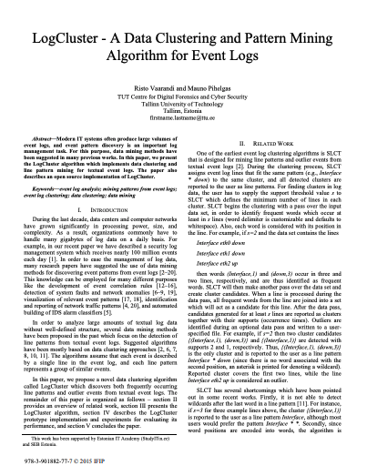
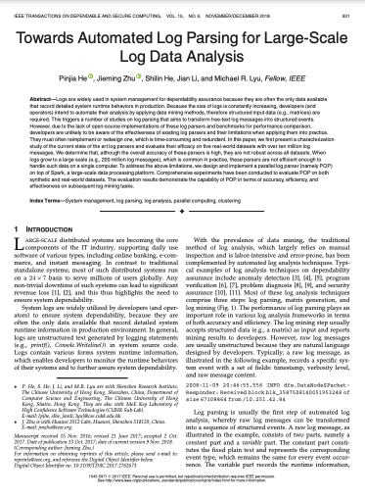
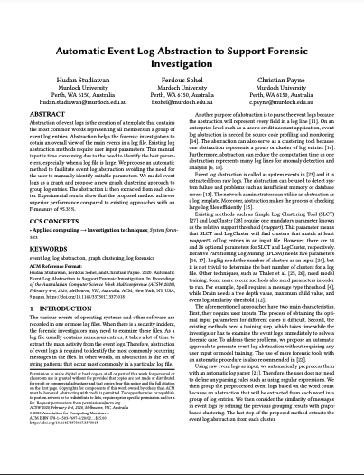
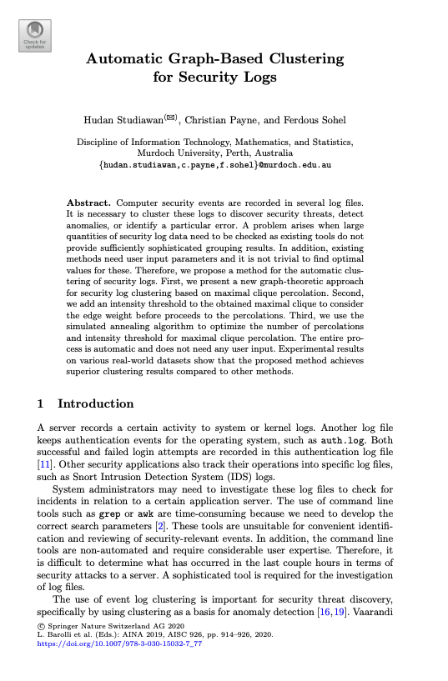
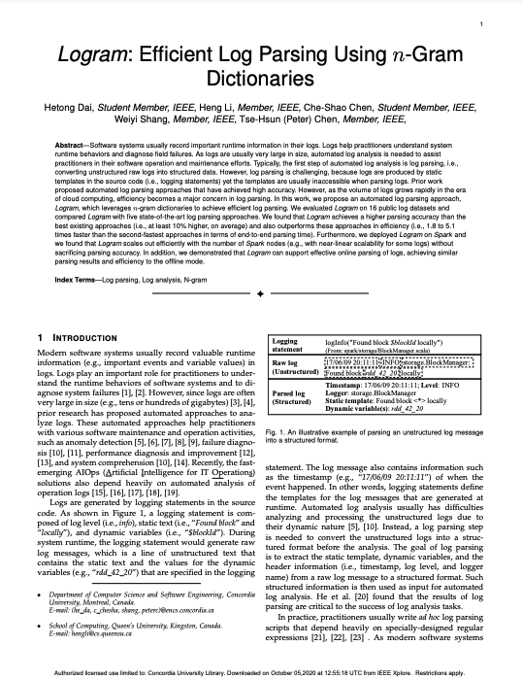
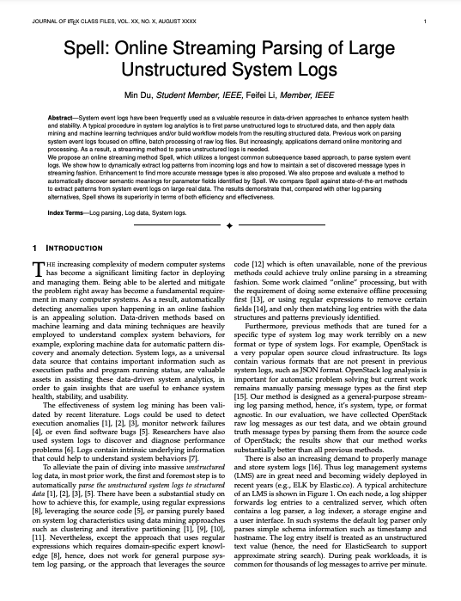
Background——Related works are not perfect.
Towards automated logparsing works better with small dataset.
Graph-based clustering is high time-consuming.
Spell is hard to interpret even with a good performance
RISTO V, PIHELGAS M. LogCluster — a data clustering and pattern mining algorithm for event logs[C]// Conference on Net-work and Service Management (CNSM). 2015: 1-7.
HEPJ,ZHUJM,HESL,etal.Towardsautomatedlogparsingfor large-scale log data analysis[J]. IEEE Transactions on Dependable and Secure Computing, 2018, 15(6): 931-944.
STUDIAWAN H, SOHEL F, PAYNE C. Automatic event log ab- straction to support forensic investigation[C]// ACSW 2020. 2020: 1-9.
STUDIAWAN H, PAYNE C, SOHEL F. Automatic graph-based clustering for security logs[C]// Advanced Information Networking and Applications(AINA). 2019: 914-926.
DAI H, LI H, CHEN C S, et al. Logram: efficient log parsing using n-gram dictionaries[R]. 2020.
DU M, LI F F. Spell: online streaming parsing of large unstructured system logs[J]. IEEE Transactions on Knowledge and Data Engi- neering, 2019, 31(11): 2213-2227.

Slide 5
Our Industry-level Solution
Log Template Extraction
Log Key Information Extraction
Time Series Detection
Abnormal Detection
Knowledge Dictionary
Log Parsing
Log Template Aggregation
Key Words
Key Phrases
Template Frequency Series
Template Match
Key-Word Match
Frequency Series Detection
Template Accumulation
Key Words Accumulation
Tokenization、Frequency Filter、SimHash Aggregation
Long Common Sequence (LCS)
Drain
Stats-based：TF-IDF、YAKE
Dictionary-based：Texttrank、multipartiterank
Ensemble: sifrank、KeyBert
Stats-based：3-sigma、IQR
Deep Learning：LSTM、VAE
Time-Series-based: Adaboll
Weighted Aggregation
Voting
Root Analysis
Abnormal Event Chain
Template Dictionary
Key words
Milestone 1
Milestone 2
Milestone 3
Milestone 4
Milestone 5

Slide 6

Development——Framework
In Put
Output
Training log
Prediction log
Log Template Parse
Template
Template Match
N
Abnormal
Y
Log Key Information Extraction
Key Words
Key Words Match
Y
Abnormal
Abnormal Aggregation
Abnormal Logs
Time Series Construction
N
Time Series Analysis
Detection Window
Abnormal Detection
N
Abnormal
Knowledge Dictionary
Key Information
Abnormal Log Template
Time Series Detection
<501 WZW hparty error Connection reset>< Connection refused ><'LSMS Failed to take effect'>
<ID1:input requestInfo MessageID * CommandCode ACT NOTIFY PortTag * ServiceType MOBILE NpCode * FlowID * >
<ID2:ErrorMessage * request *input requestInfo com.sitech.crmmci.lsms2.app.dto.EdgeInDto *>
Key Words
Template
Key Phrase
Aggregation
Root Cause
Event Chain

Slide 7
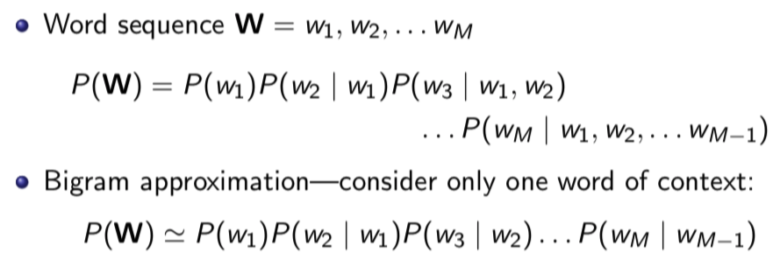
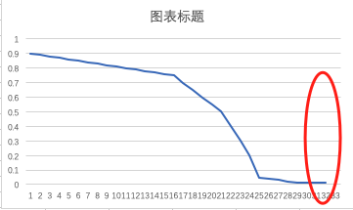
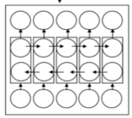
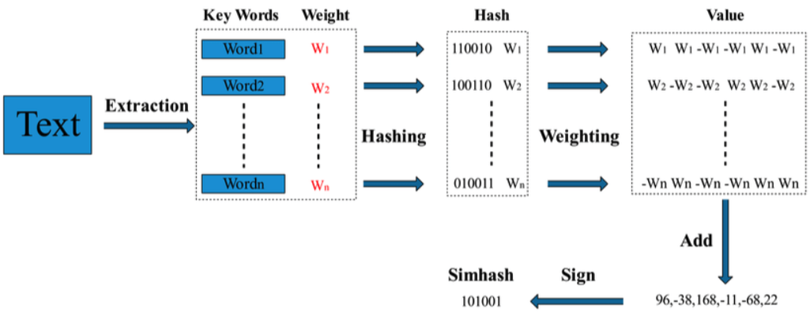
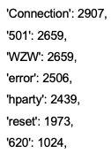
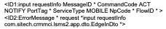
Development——Log Parsing & Key Words Extraction
Frequency-based Template Extraction
KeyBert-based Key Words Extraction
Tokenization
Preprocessing
Frequency Filter
KeyBert
（ all-MiniLM-L6-v2 Maximal Marginal Relevance）
'*’/’:NUM:’
Wildcard Replace
Simhash Aggregation
Keywords
(top N)
Template
Notes:
事件复杂度

Slide 8
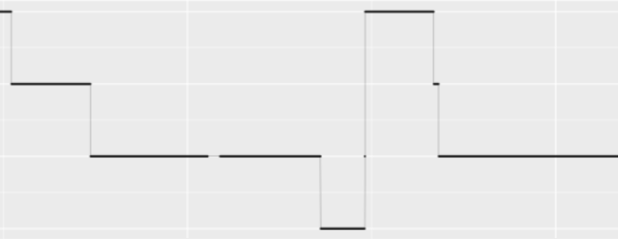
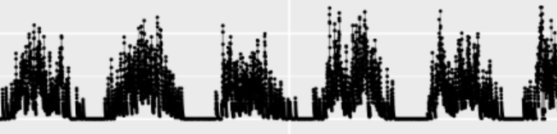
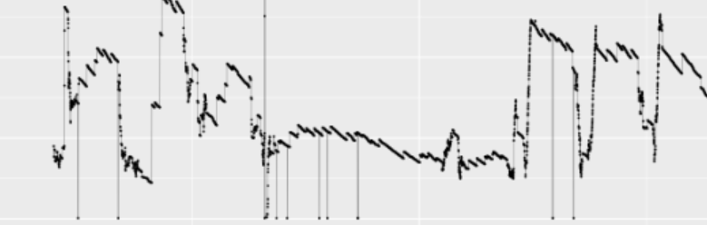
Development——Time Series Abnormal Detection
Data Input
Step Abnormal Detection
Stationary Test
Segment
Time Series
Periodical Abnormal Detection
Step
Periodical
Other
Abnormal Detection
Other Abnormal Detection
IForest
moving average
AdaBoll*
Abnormal
*:AdaBoll is proposed by our team.

Slide 9




Development——Abnormal Aggregation
Knowledge Dictionary
Abnormal Key words and pharse
Root Analysis
Abnormal Event Chain
Abnormal Detection
Abnormal Log
$$Y=X_{1}+X_{2}+X_{3}$$
$$X_{1}$$
$$X_{2}$$
$$X_{3}$$
Template-abnormal
Key-word-abnormal
Frequency-abnormal

Slide 10
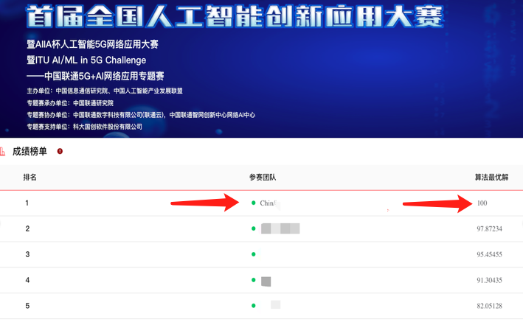
Highlights——Advantages
P=100%；R=100%；F1=1.00，Top 1 at CUC 。
Advantages
Efficient and Effective template extraction；
Increasingly accumulated knowledge dictionary and potential knowledge graph construction；
Perfect tradeoff of bias and variance；
Very low time-consuming in time series detection part LSTM
Result

Slide 11
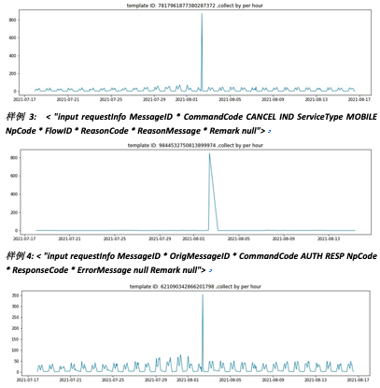
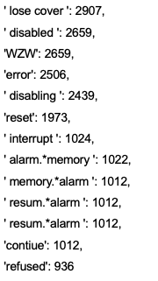
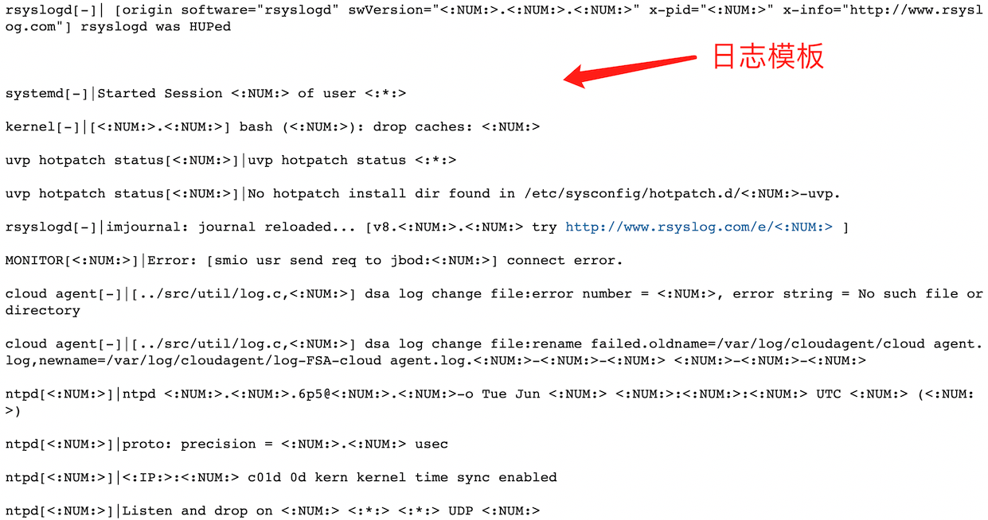
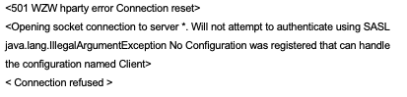
Highlights——Highly interpretable for Engineers
Highly readable and interpretable for Operation Engineers.
1、Time Series Abnormal Detection
2、Key Words
3、Log Template
4、Key Phrase

Slide 12
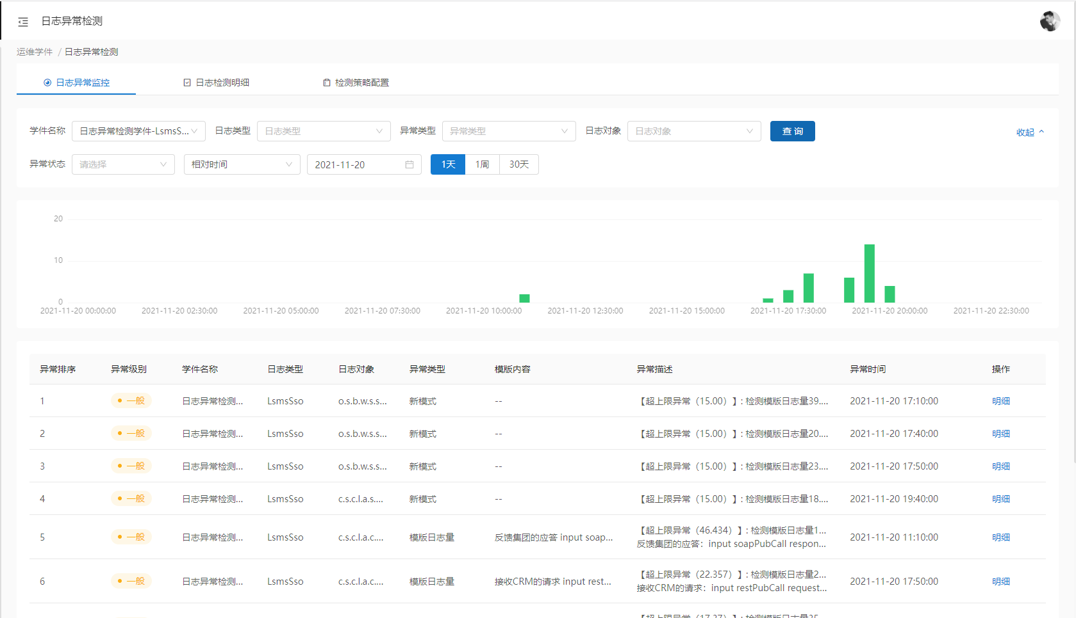
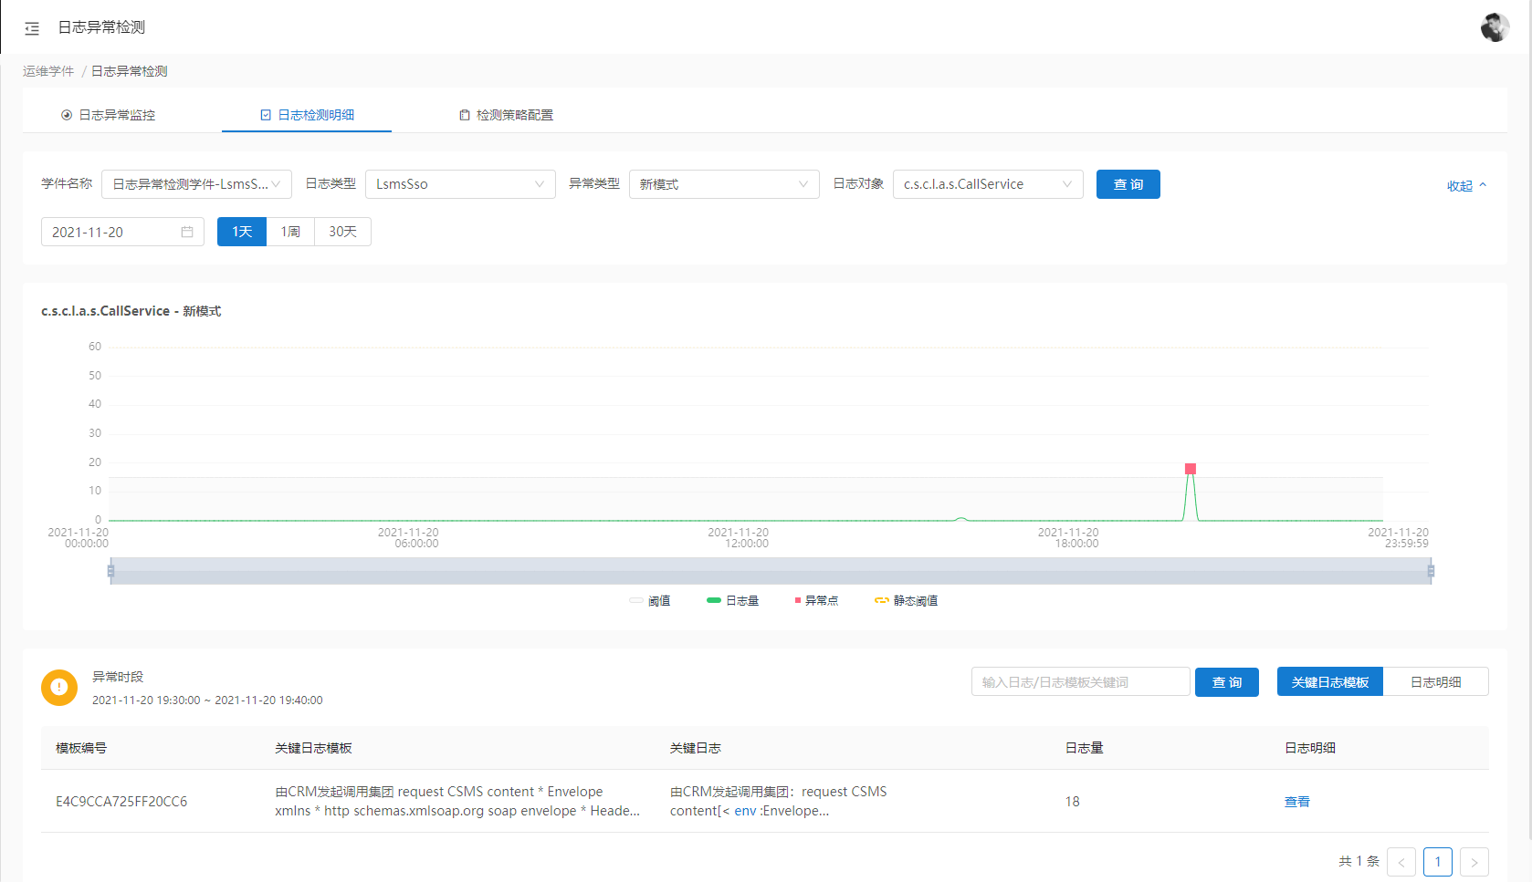
Application
Productization in AIOps
Deployed for 20+ system
Daily processed 0.92TB data with 92% accuracy

